Slide 1
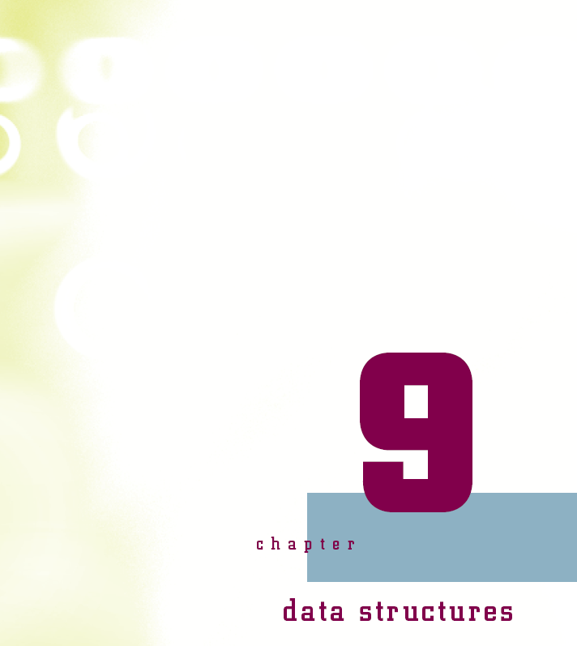
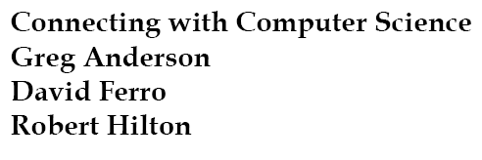

Slide 2
Objectives
Learn what a data structure is and how it is used
Learn about single and multidimensional arrays and how they work
Learn what a pointer is and how it is used in data structures
Learn that a linked list allows you to work with dynamic information

Slide 3
Objectives (continued)
Understand that a stack is a linked list and how it is used
Learn that a queue is another form of a linked list and how it is used
Learn that a binary tree is a data structure that stores information in a hierarchical order
Be introduced to several sorting routines

Slide 4
Why You Need to Know About…Data Structures
Data structures organize the data in a computer
  Efficiently access and process data
All programs use some form of data structure
Many occasions for using data structures

Slide 5
Data Structures
Data structure: way of organizing data
Types of Data structures
  Arrays, lists, stacks, queues, trees for main memory
  Other file structures for secondary storage
Computer’s memory is organized into cells
  Memory cell has a memory address and content
  Memory addresses organized consecutively
  Data structures hide physical implementation

Slide 6
Arrays
Array
  Simplest memory data structure
  Consists of a set of contiguous memory cells
  Memory cells store homogeneous data
  Data stored may be sorted or left as entered
Usefulness
  Student grades, book titles, college courses, etc.
  One variable name for large number of similar items

Slide 7
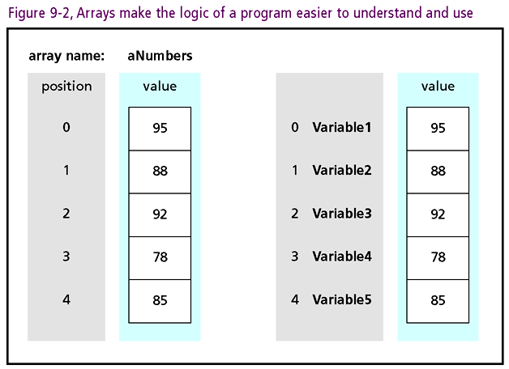

Slide 8
How An Array Works
Declaration (definition): provide data type and size
Java example: int[ ] aGrades = new int[5];
  “int[ ]” tells the computer array will hold integers
  “aGrades” is the name of the array
  “new” keyword specifies new array is being created
  “int[5]” reserves five memory locations
  “=” sign assigns aGrades as “manager” of the array
  “;” (semicolon) indicates end of statement reached
Hungarian notation: standard used to name “aGrades”

Slide 9
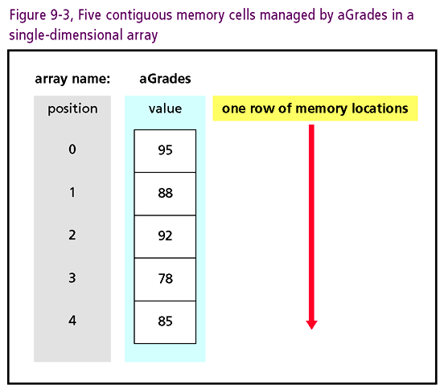

Slide 10
How An Array Works (continued)
Dimensionality
  Dimensions: rows/columns of elements (memory cells)
  aGrades has one dimension (like a row of mailboxes)
Manipulating one-dimensional arrays
  First address (position) is lower bound: zero (0)
  Next element offset by one from starting address
  Index (subscript): integer placed in “[ ]” for access
    Example: aGrades[0] = 50;
  Upper bound “off by one” from size: four (4)

Slide 11
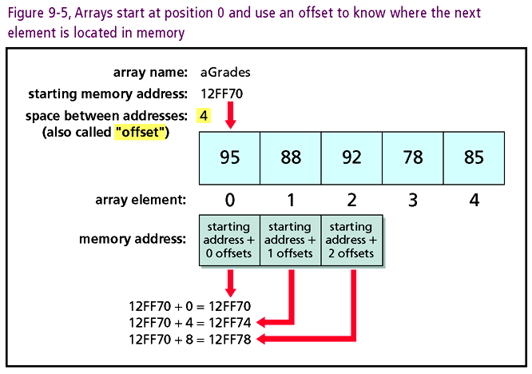

Slide 12
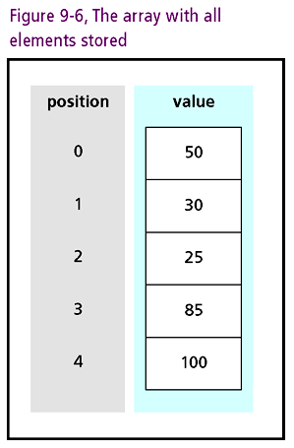

Slide 13
Multidimensional Arrays
Multidimensional arrays
  Consists of two or more single-dimensional arrays
  Multiple rows stacked on top of each other
    Apartment building mailboxes
    Tic-tac-toe boards
Definition: char[ ][ ] aTicTacToe = new char[3][3];
Assignment: aTicTacToe[1][1] = ’X’;
  place X in second row of the second column
Arrays beyond three dimensions difficult to manage

Slide 14
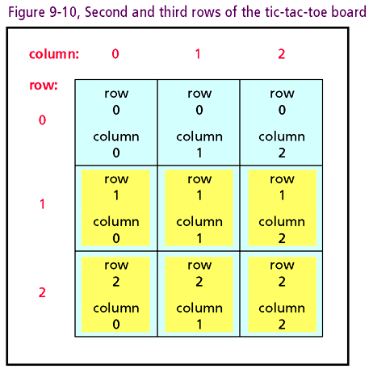

Slide 15
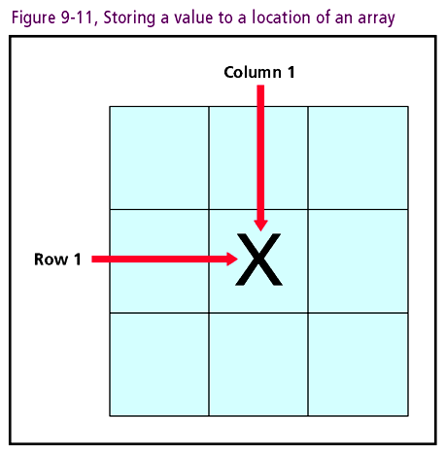

Slide 16
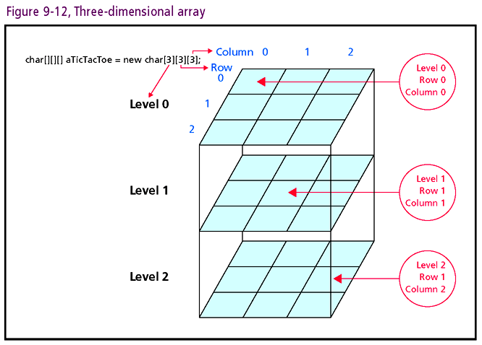

Slide 17
Uses Of Arrays
Array advantages
  Allows sequential access of memory cells
  Retrieve/store data with name and data
  Easy to implement
  Simplifies program writing and reading
Limitations and disadvantages
  Unlike classes, cannot store heterogeneous items
  Lack ability to dynamically allocate memory
  Searching unsorted arrays not efficient

Slide 18
Lists
List: dynamic data structure
  Examples: class enrollment, cars being repaired, e-mail in-boxes
  Appropriate whenever amount of data unknown or can change
Three basic list forms:
  Linked lists
  Queues
  Stacks

Slide 19
Linked lists
Linked list
  Structure used for variable data set
  Unlike an array, stores data non-contiguously
  Maintains data and address of next linked cell
  Examples: names of students visiting a professor, points scored in a video game, list of spammers
Linked lists are basis of advanced data structures
  Queues and stacks
  Each of these constructs is pointer based

Slide 20
Linked Lists (continued)
Pointers: memory cells containing address as data
  Address: location in memory
Illustration: Linked List game
  Students sit in a circle with piece of paper
  Paper has box in the upper left corner and center
  Upper left box indicates a student number
  Center box divided into two parts
  Students indicate favorite color in left part of center
  Professor has a piece of paper with a number only

Slide 21
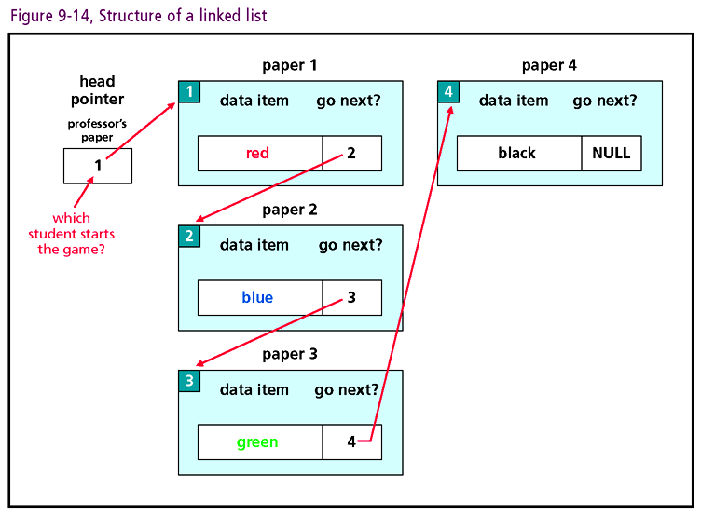

Slide 22
Linked Lists (continued)
Piece of paper represents a two-part node
  Data (the first part, the color)
  Pointer: where to go next (the student ID number)
Professor’s piece: head pointer with no data
Last student: pointer’s value is NULL
Inserting new elements
  Unlike array, no resizing needed
  Create new “piece of paper” with dual node structure
  Realign pointers to accommodate new node (paper)

Slide 23
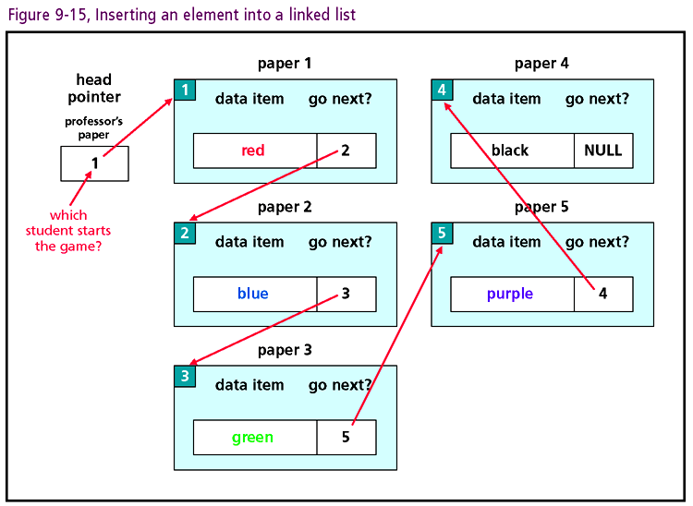

Slide 24
Linked Lists (continued)
Similar procedure for deleting items
  Modify pointer of element preceding target item
  Students deleted from list without moving elements
Dynamic memory allocation
  Linked lists more efficient than arrays
  Memory cells need not be contiguous

Slide 25
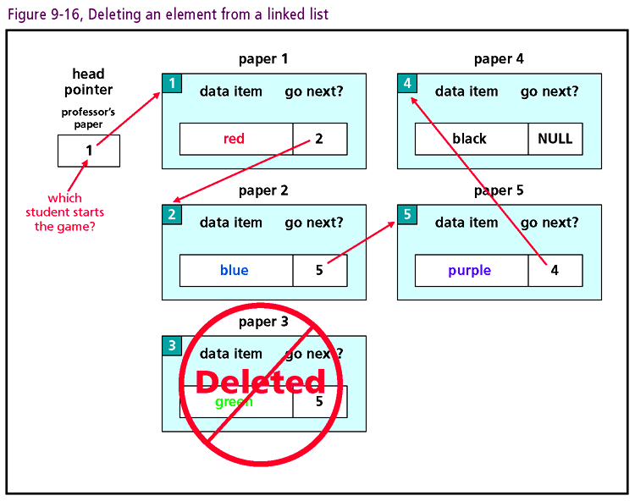

Slide 26
Stacks
Stack: Special form of a list
  To store new items, “push” them onto the list
  To retrieve current items, “pop” them off the list
Analogies
  Spring loaded plate holder in a cafeteria
  Character buffer for a text editor
LIFO data structure
  First item pushed onto stack has waited longest
  First item popped from stack is most recent addition

Slide 27
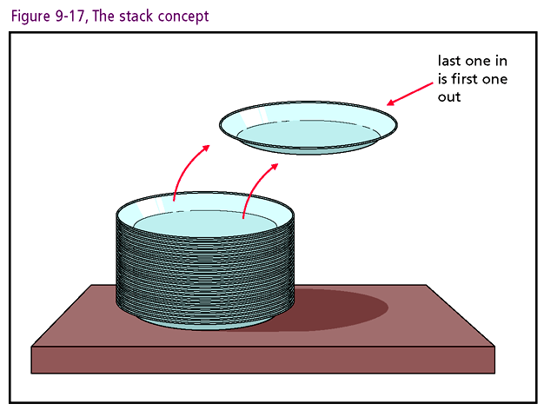

Slide 28
Stacks (continued)
Uses Of A Stack: processing source code
  Source code logically organized into procedures
  Keep track of procedure calls with a stack
  Address of procedure popped off stack
Back To Pointers: stack pointer monitors stack top
Check stack before applying pop or push operations
Stacks, like linked lists and arrays, are memory locations organized into logical structures

Slide 29
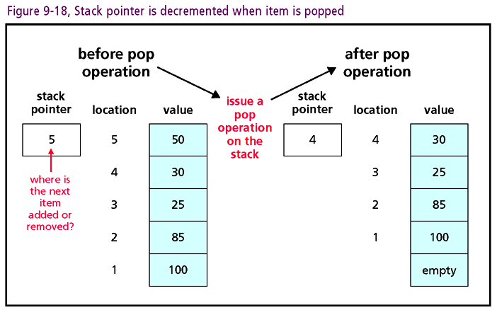

Slide 30
Queues
Queue: another type of linked list
  Implements first in, first out (FIFO) storage system
  Insertions made at the end of the queue
  Deletions made at the beginning
  Similar to that of a waiting line
Uses Of A Queue: printer example
  First item printed is the document waiting longest
  Current item deleted from queue, next item printed
  New documents placed at the end of the queue

Slide 31
Queues (continued)
Pointers Again
  Head pointer tracks beginning of queue
  Tail pointer tracks end of the queue
Dequeue operation
  Remove item (oldest entry) from the queue
  Head pointer changed to point to the next item in list
Enqueue operation
  Item placed at list end and the tail pointer is updated

Slide 32
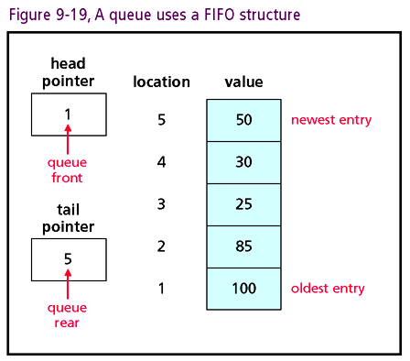

Slide 33
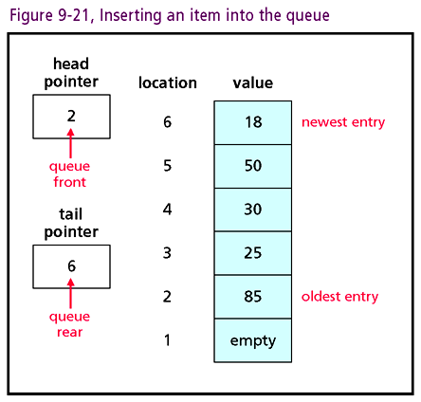

Slide 34
Trees
Tree: hierarchical data structure similar to organizational or genealogy charts
  Each position in the tree is called a node or vertex
  Node that begins the tree is called the root
  Nodes exist in parent-child relationship
  Node without children called a leaf node
  Depth (level): refers to distance from root node
  Height: maximum number of levels

Slide 35
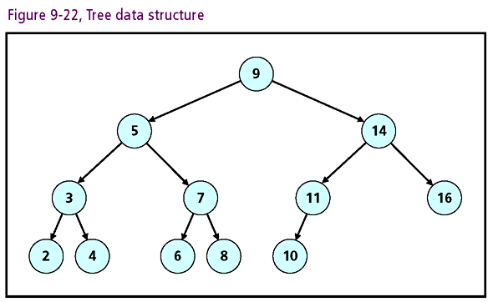

Slide 36
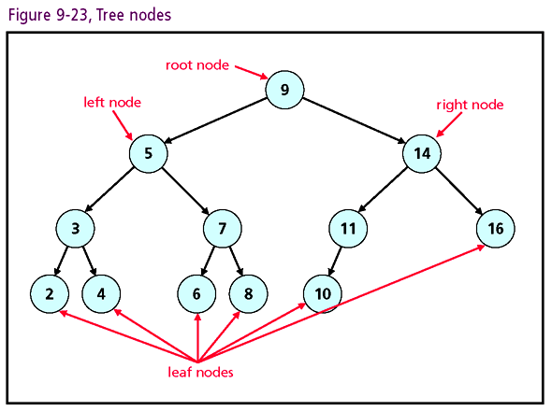

Slide 37
Trees (continued)
Binary tree: a type of tree
  Parent node may have zero, one, or two child nodes
  Child distinguished by positions “left” or “right”
Binary search tree: a type of binary tree
  Data value of left child node < value of parent node
  Data value of right child node > value of parent node
Binary search trees are useful search structures

Slide 38
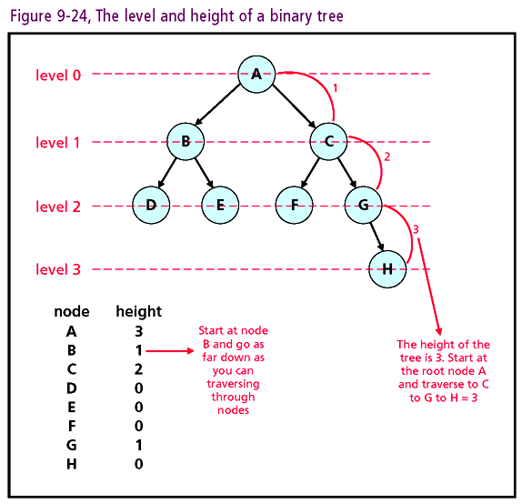

Slide 39
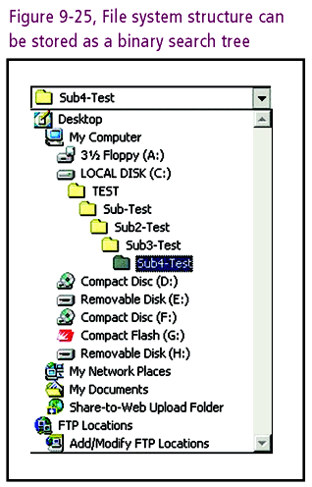

Slide 40
Searching a Binary Tree
A node in a binary search tree contains three components
  Left child pointer
  Right child pointer
  Data
Root: provides the initial starting access to the tree
Prerequisite: binary search tree properly defined

Slide 41
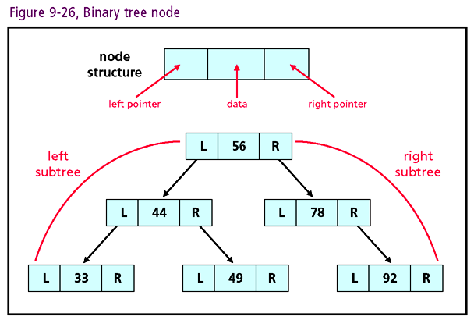

Slide 42
Searching a Binary Tree (continued)
Search routine
  Start at the root position
  Determine if path moves to left child or right
  Move in direction of data (left or right)
  If value found, stop at node and return to caller
  If value not found, repeat process with child node
  Child with NULL pointer blocks path
  While paths can be formed, continue search
    Result: value is either found or not found

Slide 43
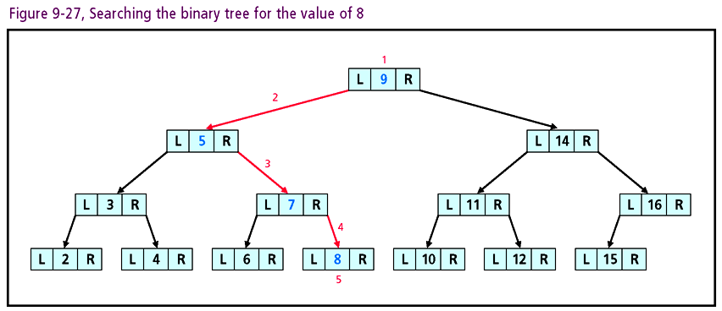

Slide 44
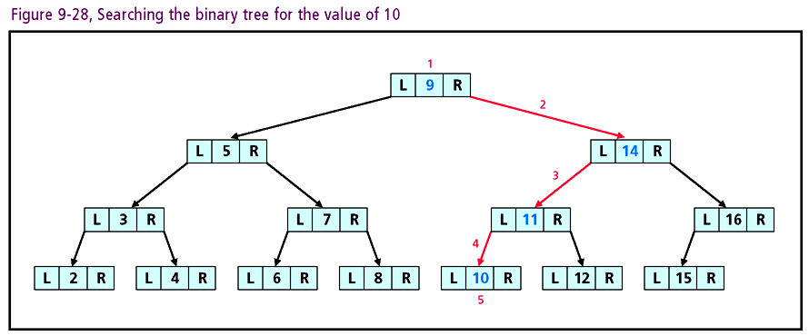

Slide 45
Sorting Algorithms
Sorting: leverages data structures to organize data
Some example of data being sorted:
  Words in a dictionary
  Files in a directory
  Index of a book
  Course offerings at the university
Algorithms define the process for sorting
  No universal sorting routines
  Focus: selection and bubble sorts

Slide 46
Selection Sort
Selection sort: mimics manual sorting
  Find smallest value in a list
  Exchange with item in first position
  Move to second position
  Repeat process with reduced list (less first position)
  Continue process until second to last item
Selection sort is simple to use and implement
Selection sort inefficient for large lists

Slide 47
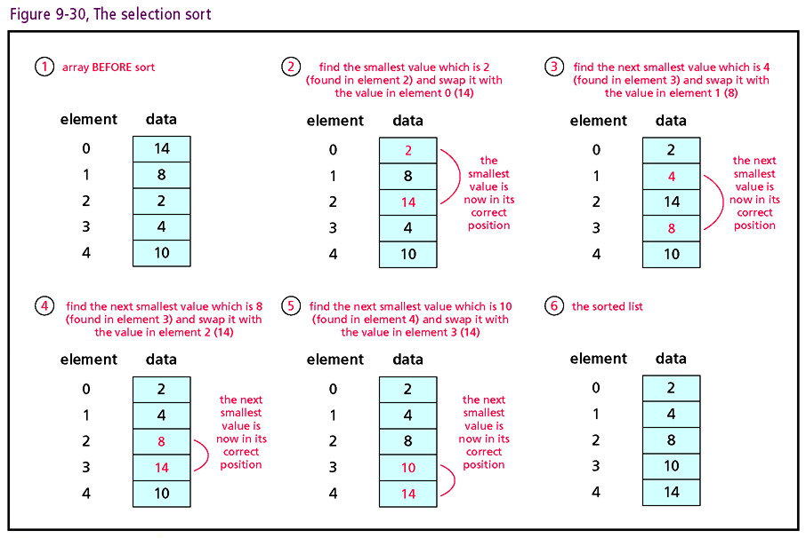

Slide 48
Bubble Sort
Bubble: one of the oldest sort methods
  Start with the last element in the list
  Compare its value to that of the item just above
  If smaller, change positions and continue up list
    Continue comparison until smaller item found
  If not smaller, next item compared to item above
  Check until smallest value “bubbles” to the top
  Process repeated for list less first item
Bubble sort to simple implement
Bubble Sort inefficient for large lists

Slide 49
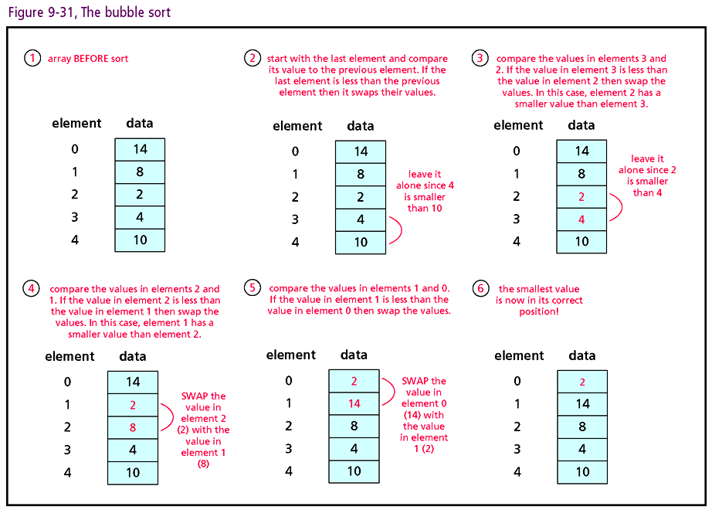

Slide 50
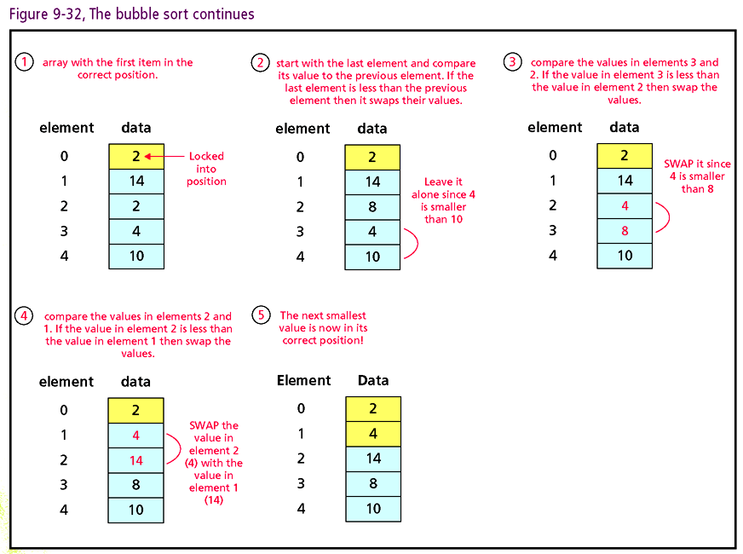

Slide 51
Other Types Of Sorts
Other sorting routines
  Quicksort, merge sort, insertion sort, shell sort
  Process data with fewer comparisons
  More time efficient than selection and bubble sorts
Quicksort
  Incorporates “divide and conquer” logic
    Two small lists easier to sort than one large list
  Uses recursion, (self calls), to break down problem
  All sorted sub-lists combined into single sorted list
  Very fast and useful with large data set

Slide 52
Other Type of Sorts (continued)
Merge sort: similar to the quicksort
  Continuously halves data sets using recursion
  Sorted halves merged back into one list
  Time efficient, but not as space efficient as quicksort
Insertion sort: simulates manual sorting of cards
  Requires two lists
  Not complex, but inefficient for list size > 1000
Shell sort: uses insertion sort against expanding data set

Slide 53
One Last Thought
Essential foundations: data structures and sorting and searching algorithms
Acquaint yourself with publicly available routines
Do not waste time “reinventing the wheel”
Factors to consider when implementing sort routines
  Complexity of programming code
  Time and space efficiencies

Slide 54
Summary
Data structures organize data
Basic data structures: arrays, linked lists, queues, stacks, trees
Arrays store data contiguously
Arrays may have one or more dimensions
Linked lists store data in dynamic containers

Slide 55
Summary (continued)
Linked lists use pointers for non-contiguous storage
Pointer: variable’s datatype is memory address
Stack: linked list structured as LIFO container
Queue: linked list structured as FIFO container
Tree: hierarchical structure consisting of nodes

Slide 56
Summary (continued)
Binary tree: nodes have at most two children
Binary search tree: left child < parent < right child
Sorting Algorithms: organize data within structure
Names of sorting routines: selection sort, bubble sort, quicksort, merge sort, insertion sort, shell sort
Sorting routines analyzed by code, space, time complexities

